Slide 1
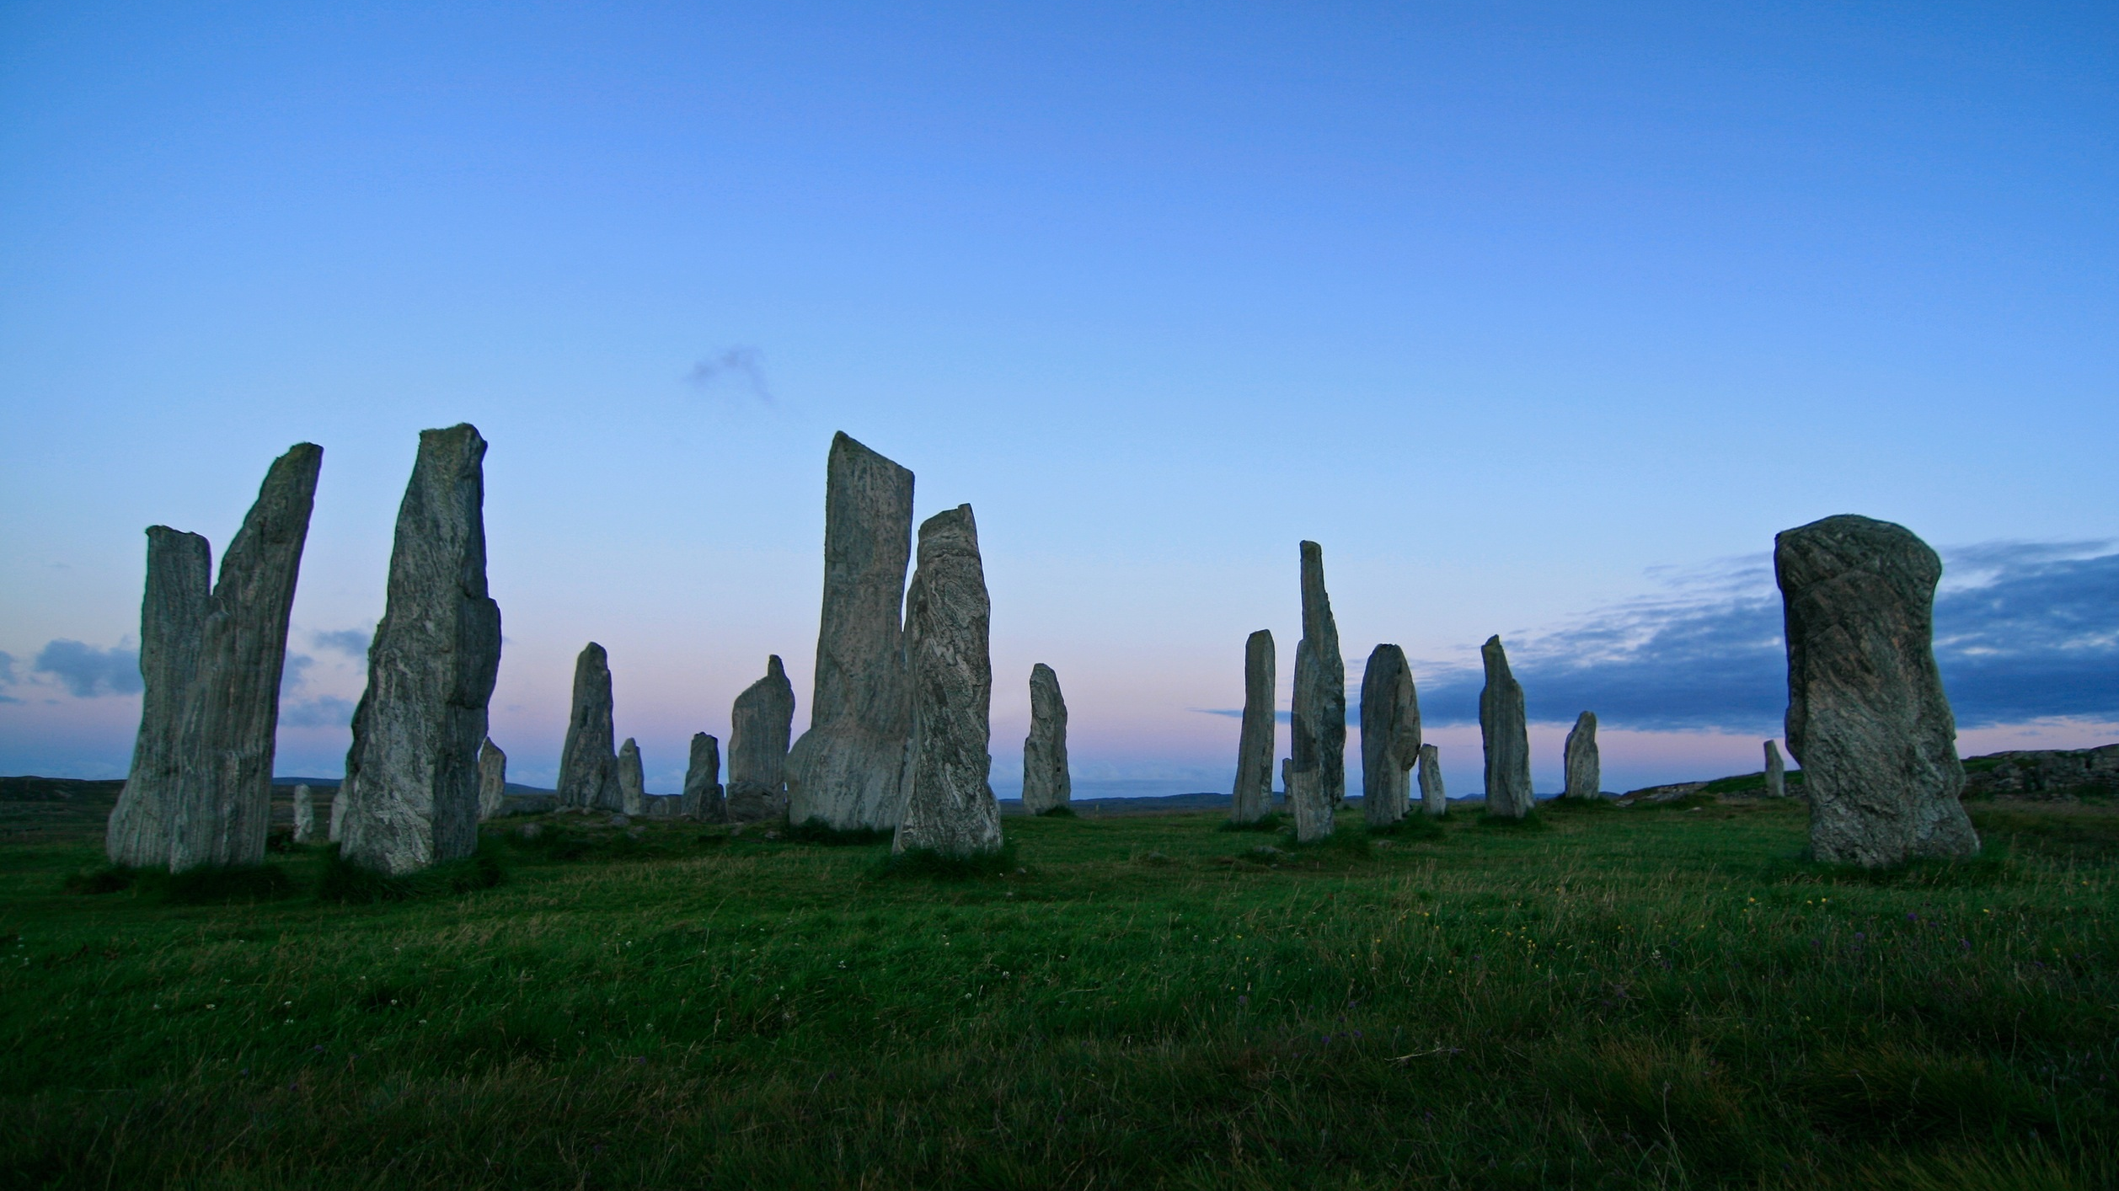

Anett Richel
Lukas Qualo
Ben Samtleben
Project for a calendar web application

Slide 2
What you need to know
What is the vision behind EventLAB?
What expectations do users have on our application?
Who is creating EventLAB?
How do we organize our team?
How is EventLAB designed?
How do we fulfill quality standards?
Live Demo

Slide 3
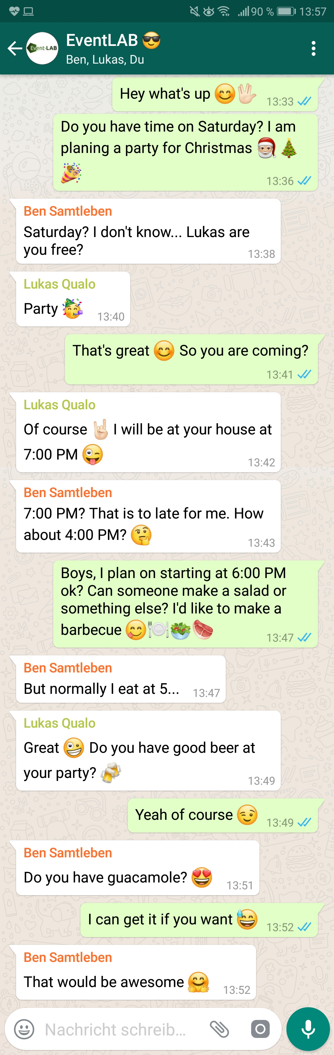
Motivation
Endless discussions about:
When and where do we meet?
Who will bring what?
Can everyone attend?
Scrolling through loads of different groups & messages
Confusion included for free!

Slide 4
Our Vision Why should you choose EventLAB?
Intuitive Easy-to-use for everybody
Organized Events organized in groups, each event has its own what-to-bring list
Simple No unnecessary features. Just focus on your task!
Accessible A global web application for people around the world
Inventive Useful features, inspired by successful applications
Notes:
Combining the very best features of various calendar applications!

Slide 5

Our Vision
Combining the very best features of various calendar applications!

Slide 6

Our Team
U
K
A
S
N
E T T
E
N

Slide 7
Our Team
LUKAS
Project Manager, Implementer, Test Designer
Product Owner, Designer, Configuration Manager
Tech Writer, Course Developer, Tester, Scrum Master
ANETT
BEN

Slide 8
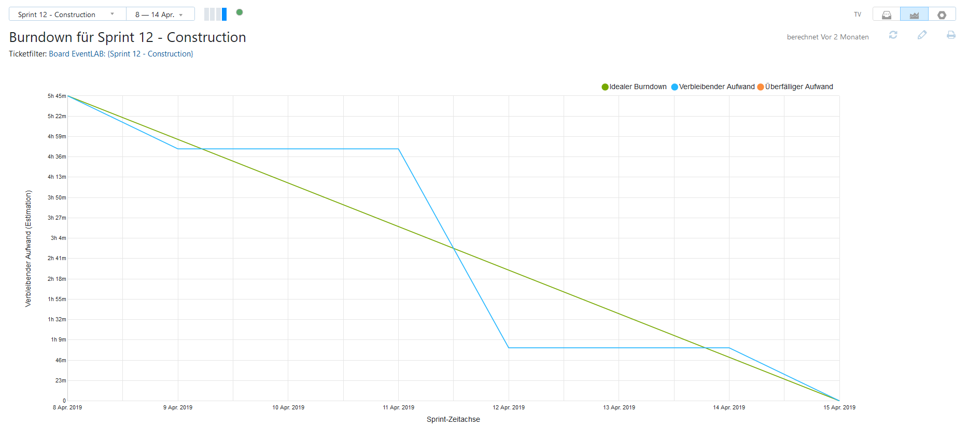
Burndown Chart

Slide 9
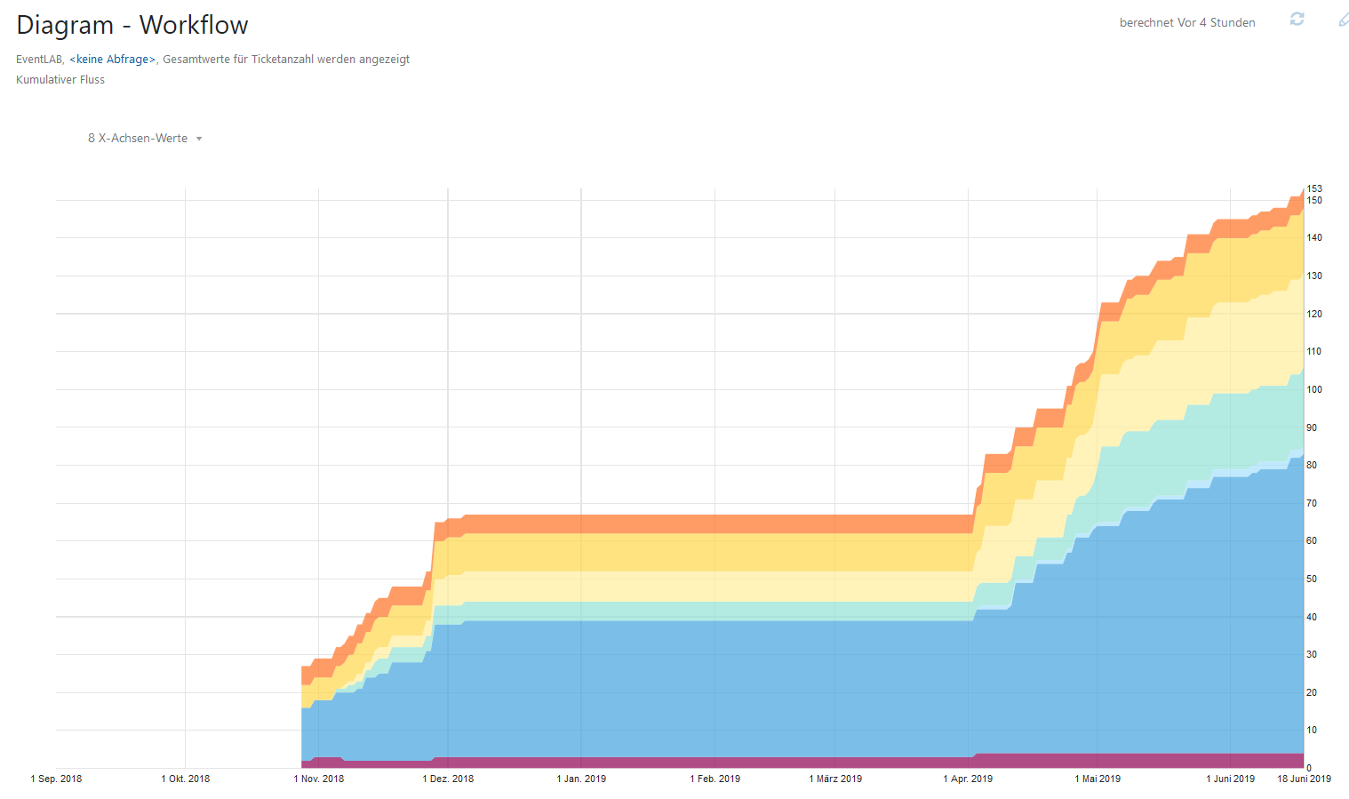
Workflow Diagram

Slide 10
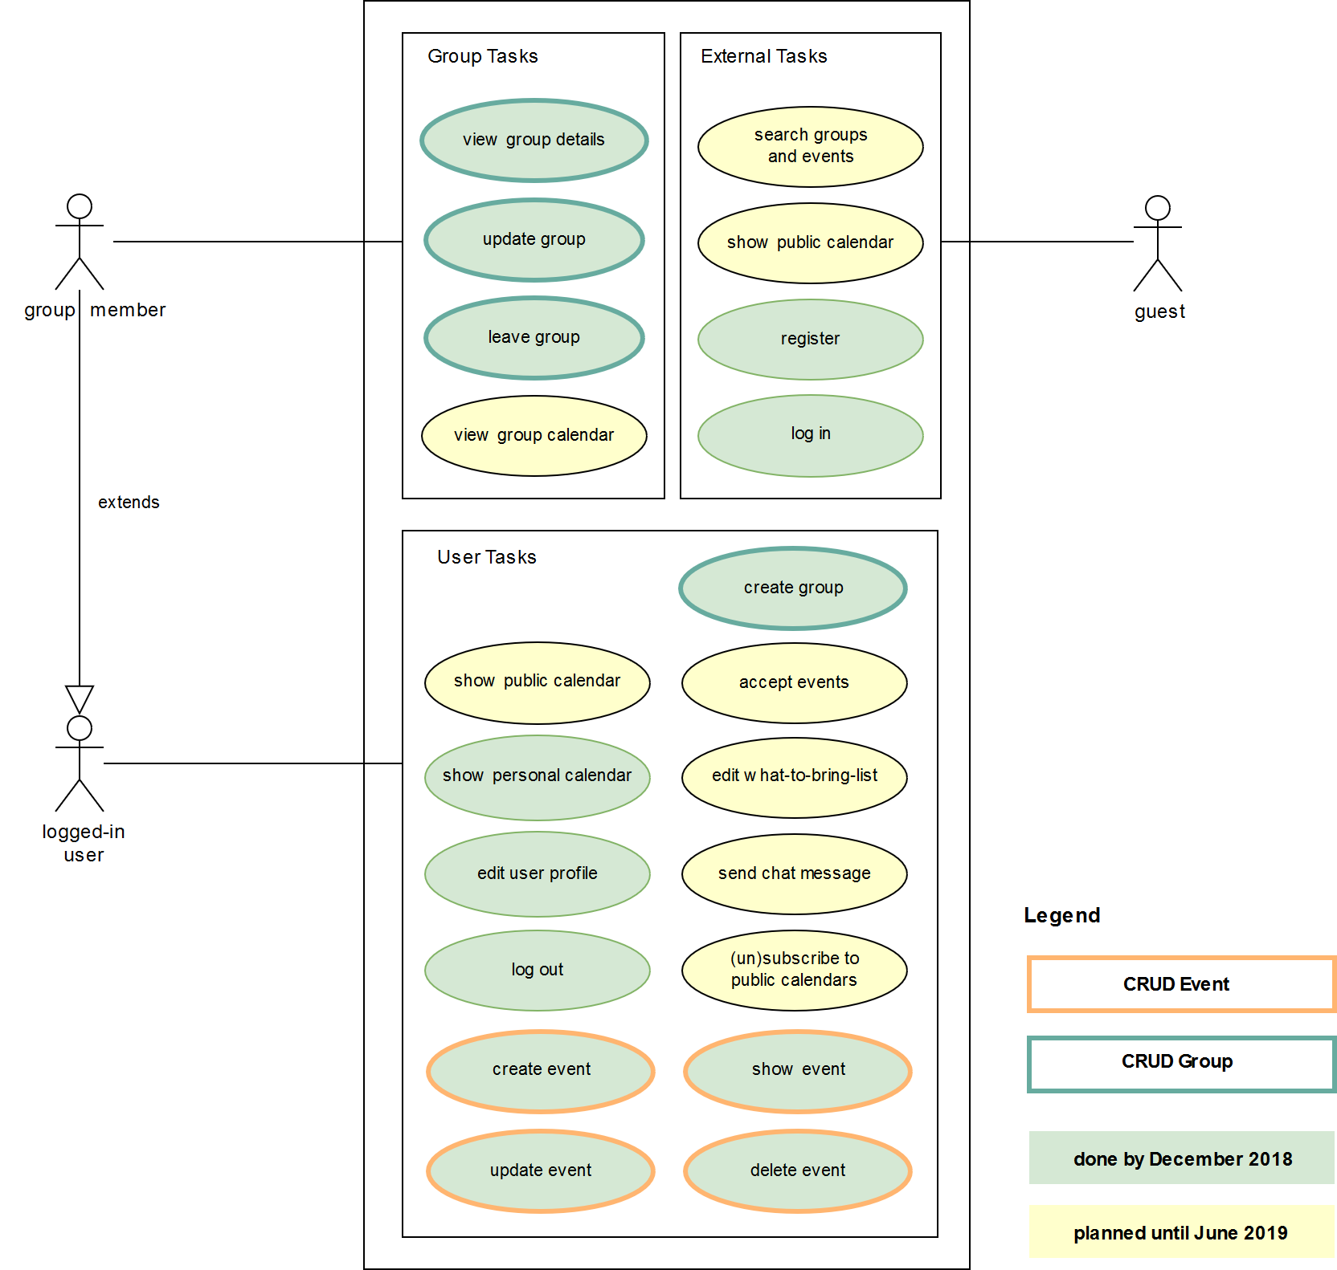
Tasks & Expectations

Slide 12

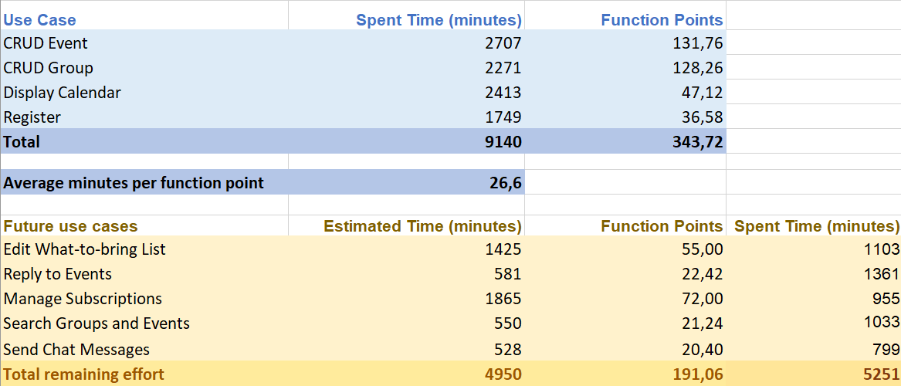
Function Points
More on GitHub

Slide 13
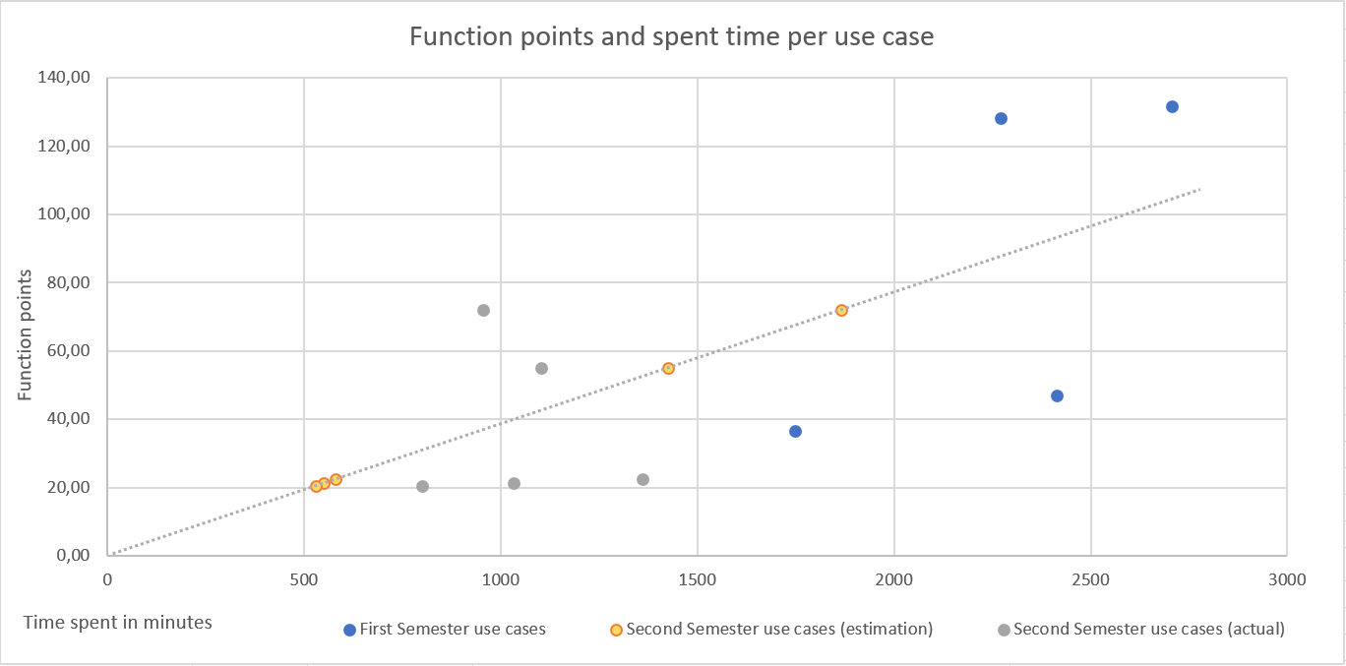
Function Points
More on GitHub

Slide 14
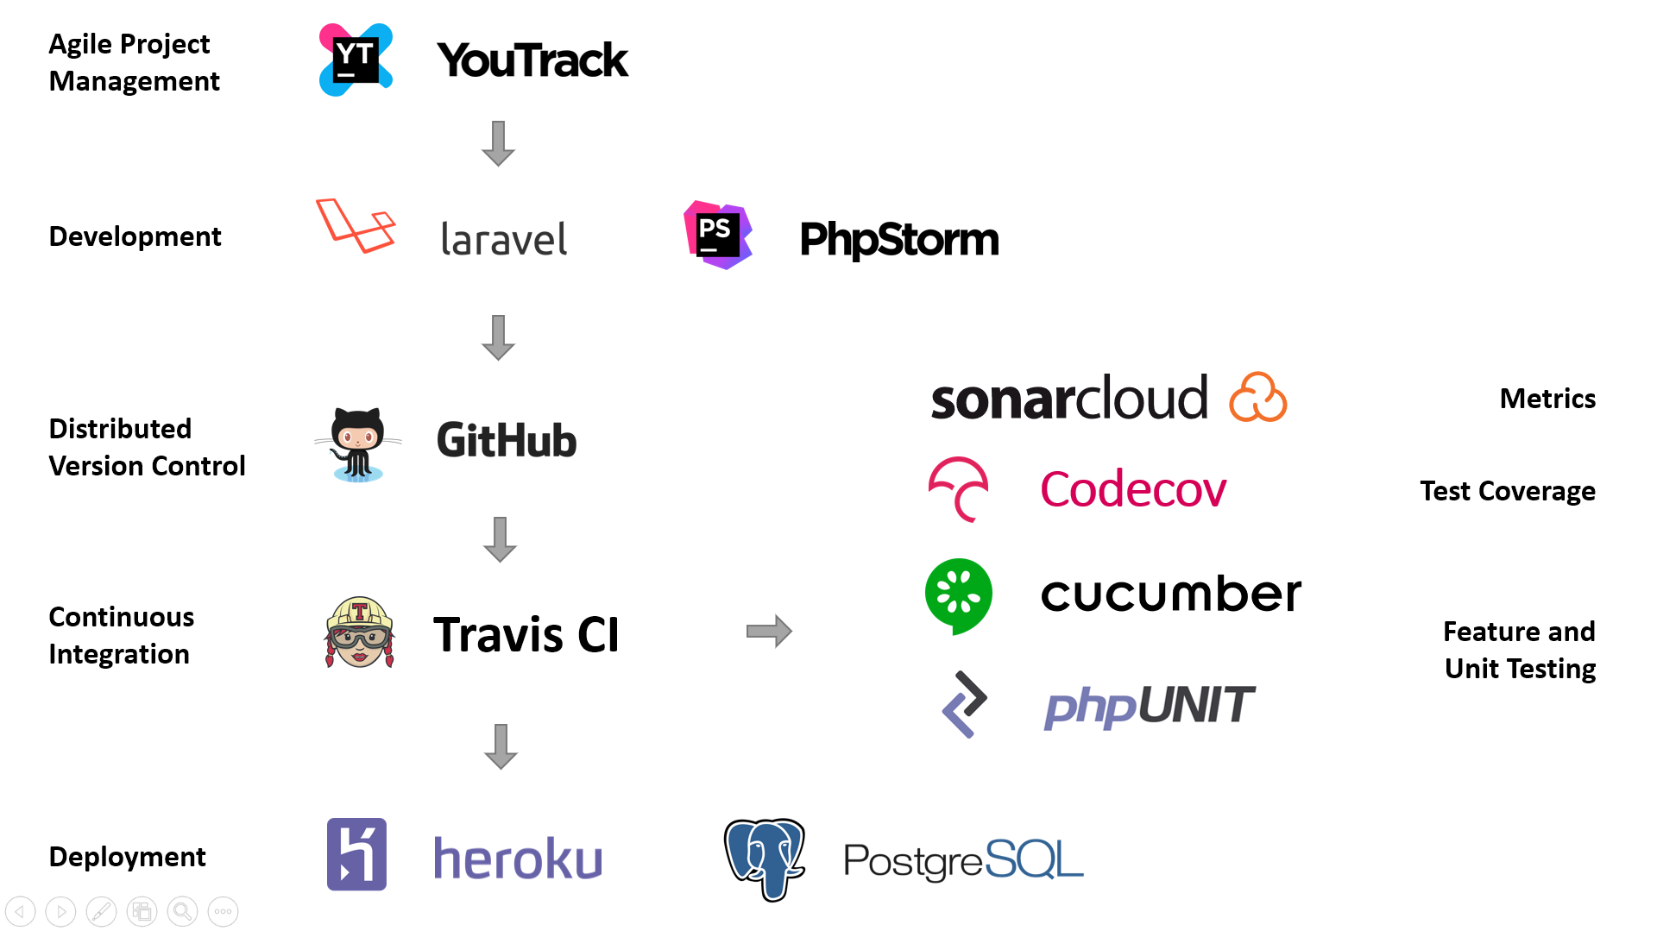
Project Overview

Slide 15
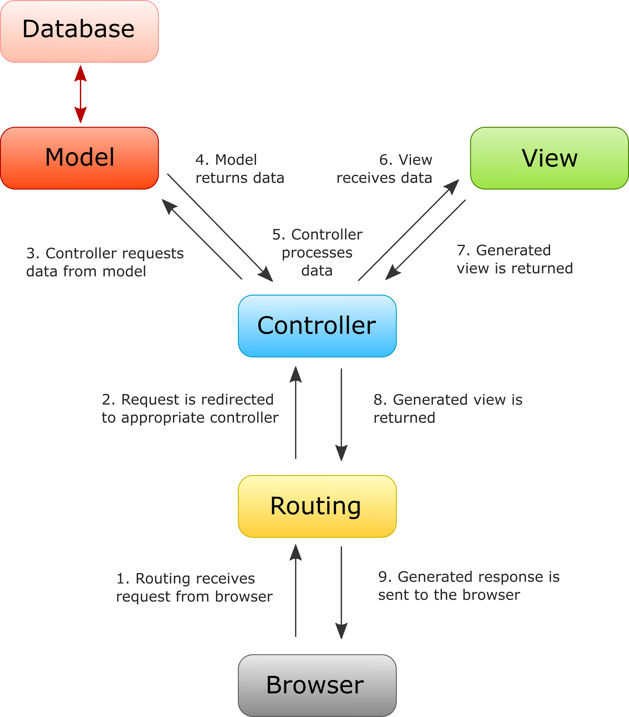

M V C A R C H I T E C T U R E

Slide 16
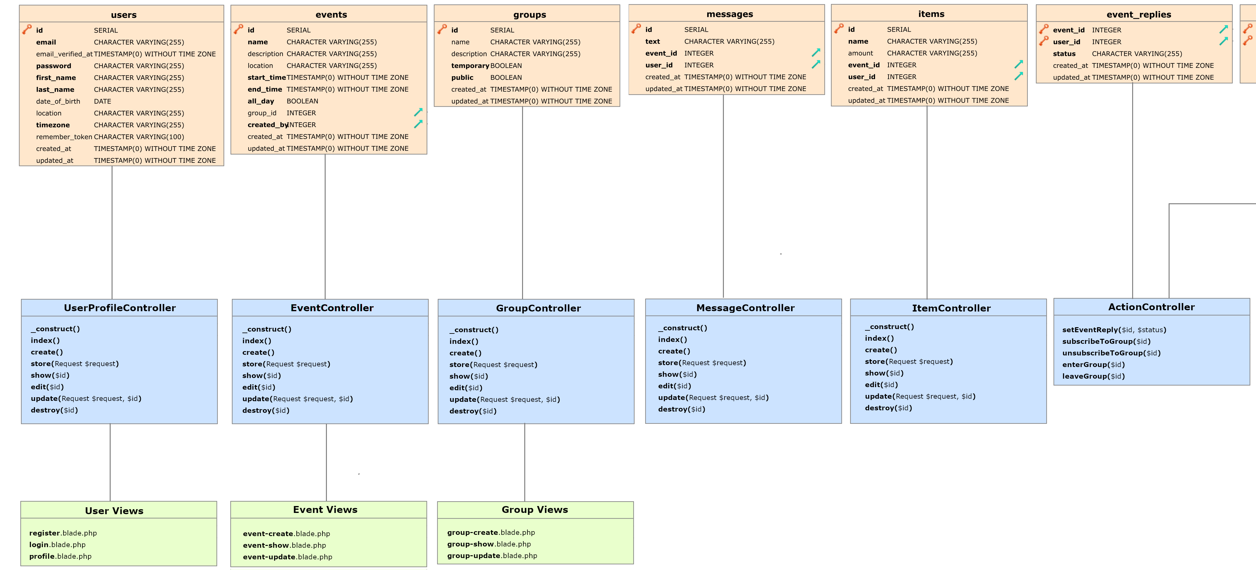
Class Diagram
Notes:
Pattern implementiert

Slide 17
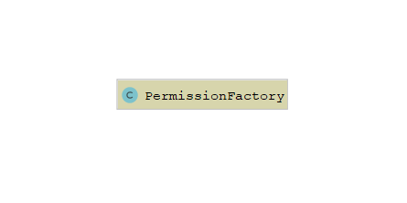
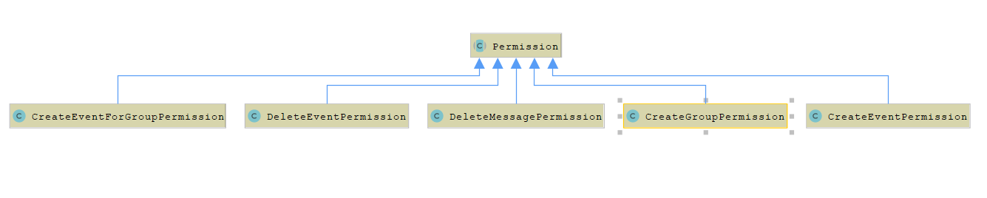
Factory Method Design Pattern

Slide 18
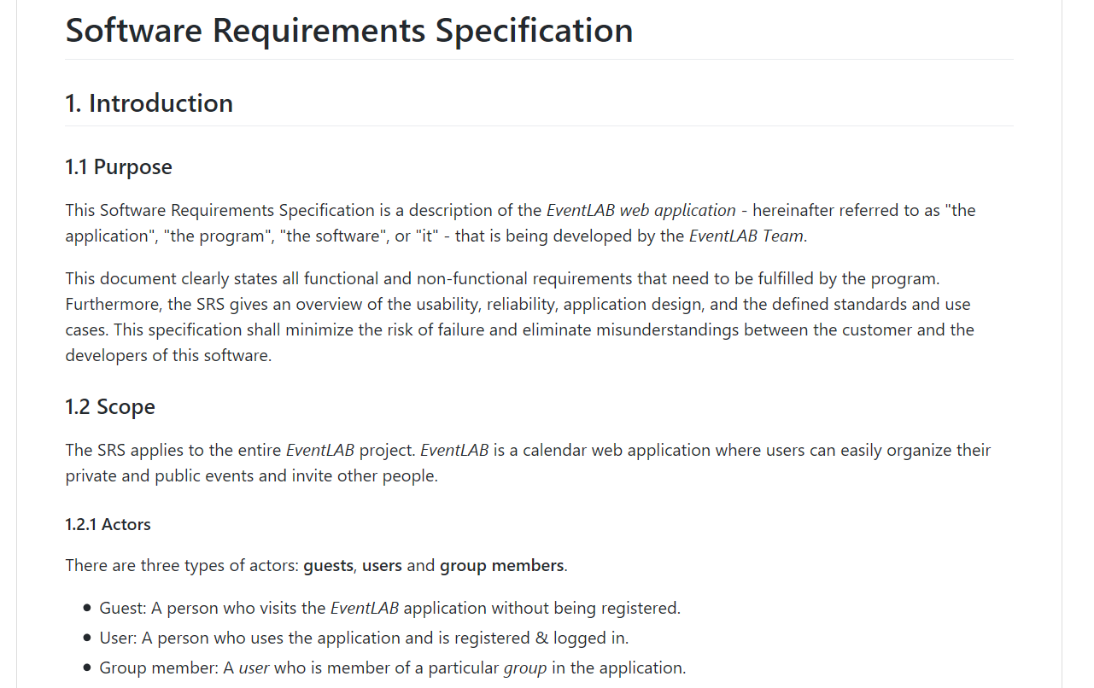
Quality
More on GitHub
Software requirements specification clarifies all requirements and use case expectations
Software architecture document for project structure and clean hand-over
Test plan including our test strategies, risks and metrics

Slide 19
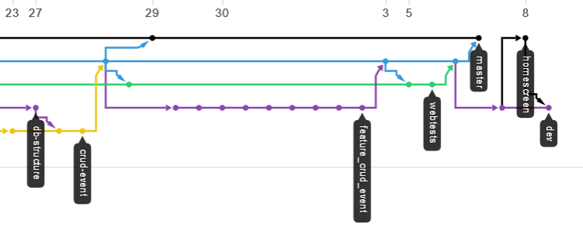
Version Control - GitHub
Multiple branches for different stages → production, development
Pull requests need to be approved by another author
Continuous integration tests need to succeed before each merge

Slide 20
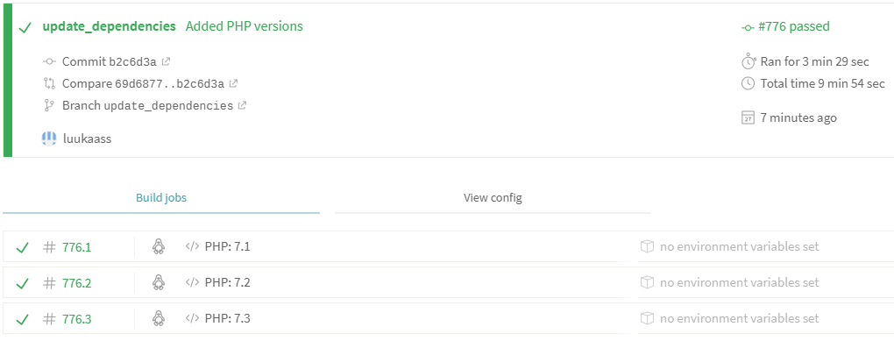

Continuous Integration - Travis CI

Slide 21
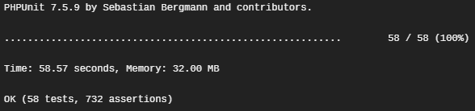
Continuous Integration - Travis CI

Slide 22
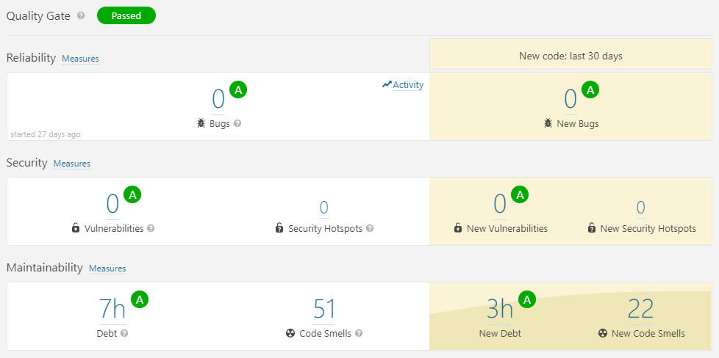
Metrics - SonarQube

Slide 23
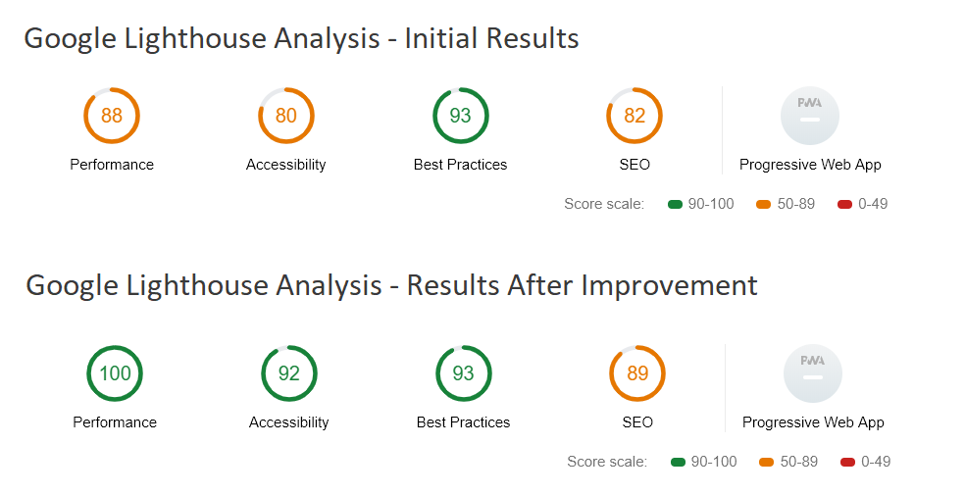
Metrics - Lighthouse

Slide 24
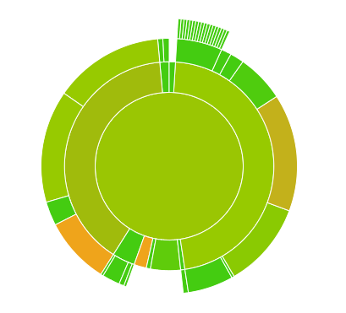

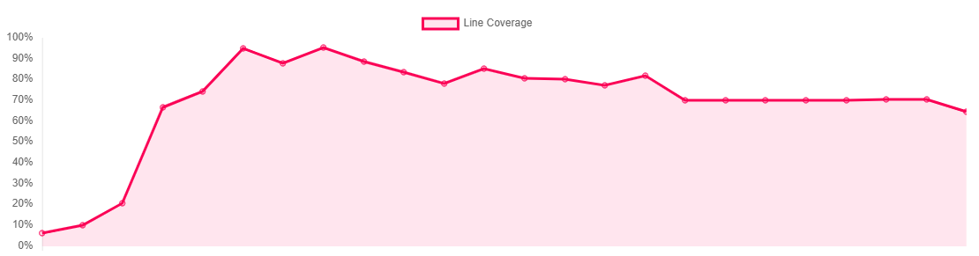
Test Coverage - Codecov

Slide 25

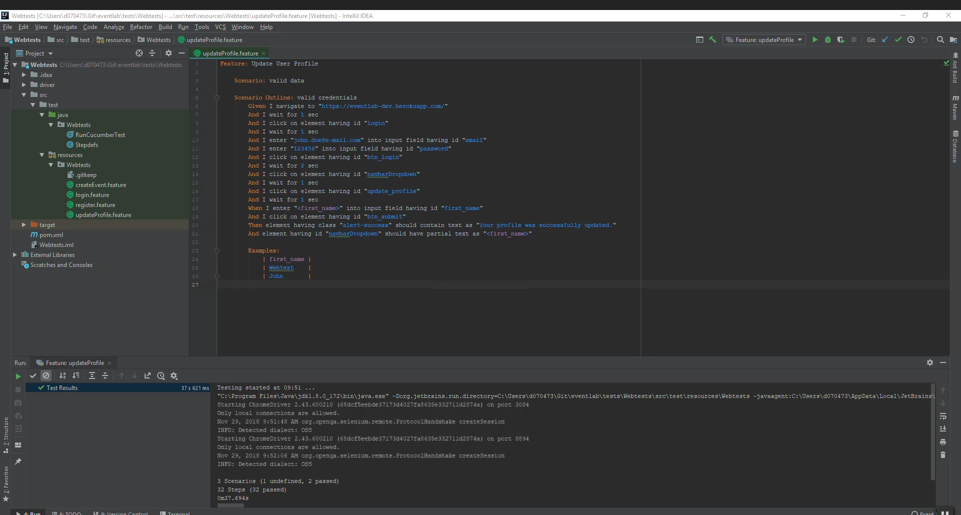
Feature Tests
More on GitHub

Slide 26
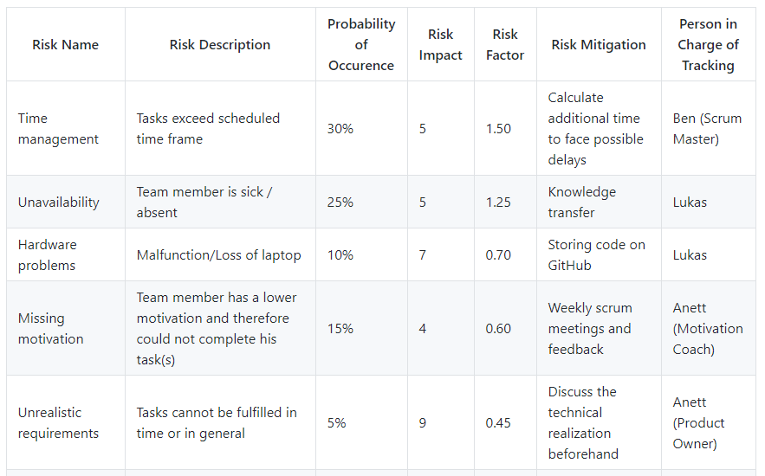
Risk Management
More on GitHub

Slide 27

Live Demo

Slide 28


What’s next?
Subscriptions & public calendars
Chat & What-to-bring list
Accepting and declining events
Notifications

Slide 29

Anett Richel
Lukas Qualo
Ben Samtleben
EventLAB. We simplify meeting the world.

